Slide 1
Spectrum Regulatory Challenges for 5G Session 4 –spectrum policies in the new digital 5G ecosystem
CEPT ECC Vice Chairman
Jaime Afonso
9th International Conference
Electronic Communications & Postal Services in the Digital Single Market 8 & 9 June 2017 – Athens, Greece

Slide 2
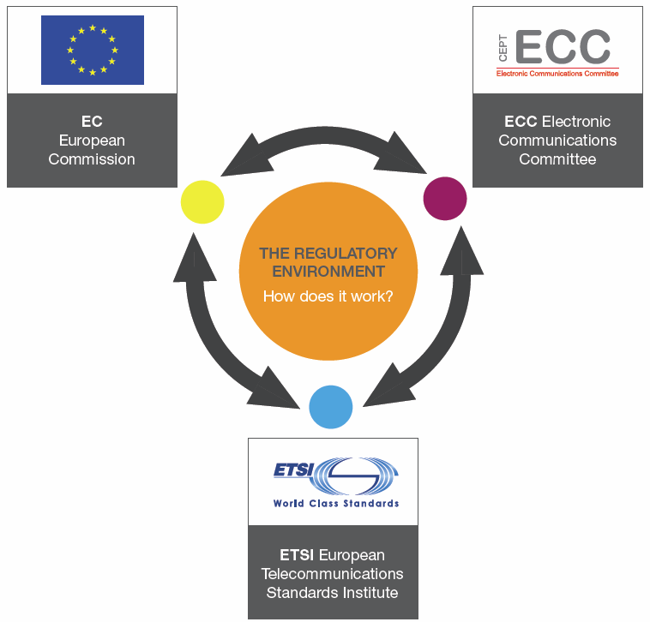
ECC: what we do
The ECC:
Brings together representatives from CEPT members (48)
Develops common policies and regulations
A focal point for information on spectrum use
Offers a wide forum for the preparation of the work in ITU
Cooperates with several bodies
The strategic plan (2015-2020)
Major challenges and topics (e.g. 5G, the 700 MHz)

Slide 3
5G: the context the ”mobile spectrum”
Harmonised frequency bands in ECC framework
Band | Size (MHz) | ECC framework (main deliverables)
700 MHz (694- 790 MHz) | 2x30 + 20 (option 0 to 4 blocks of 5 MHz) (SDL) | ECC DEC(15)01
800 MHz (790-862 MHz) | 2x30 | ECC DEC(09)03
900 MHz (880-915 MHZ /925-960 MHz) | 2x35 | ECC DEC(06)13
1452-1492 MHz | 40 (SDL) | ECC DEC(13)03
1.8 GHz (1710-1785 MHz/1805-1880 MHz) | 2x75 | ECC DEC(06)13
2 GHz (1920-1980MHz/210-2170 MHz) | 2x60 | ECC DEC(06)01
2.3-2.4 GHz | 100 | ECC DEC(14)02
2.6 GHz (2500-2690 MHz) | 2x70+50 | ECC DEC(05)05
3.4-3.8 GHz | 400 | ECC DEC(11)06
 | Total : 1210 MHz

Slide 4
5G: the context the basics
The “5G” vision – IMT. 2020
“5G” as the enabler of different applications, “use cases”
Source: ITU-R Rec. M.2083

Slide 5
5G IN CEPT: actions and challenges the roadmap
Developed in close cooperation with stakeholders
CEPT Roadmap for 5G”¹ outlines the CEPT’s actions for 5G
Harmonisation of frequency bands (arrangements, technical conditions)
Objectives in the context of the preparation of WRC-19
Verticals (the different use cases)
Other spectrum challenges (e.g. the use of higher bands)
Work items currently being addressed in CEPT ECC
¹http://www.cept.org/Documents/ecc/35302/ecc-17-034-annex-05_roadmap-for-5g-march-2017

Slide 6
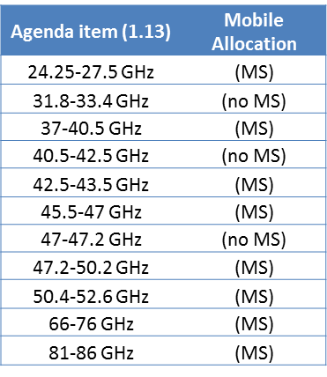
5G IN CEPT: actions and challenges the spectrum
“5G” in the context of WRC-19
Extensive use (fixed, satellite, passive, radars, etc..)
IMT spectrum needs and sharing/compatibility studies
Current focus in the frequency bands 24.25-27.5 GHz,
31.8-33.4 GHz and 40.5-43.5 GHz
Current priority: 24.25-27.5 GHz band before WRC-19
The 27.5-29.5 GHz band is not available for 5G
European Commission Mandate to CEPT on 5G
3.4 – 3.8 GHz and 24.25-27.5 GHz: channeling arrangements and technical conditions for 5G

Slide 7
5G IN CEPT: actions and challenges other issues to be considered by CEPT
Requirements of vertical industries in the context of 5G (e.g. PPDR, industrial automation, automotive, utilities, rail, …)
Issues such as satellite solutions for 5G, new sharing opportunities and challenges (e.g. MIMO),infrastructure and backhaul requirements
Machine to Machine requirements
Could be implemented in any mobile MFCN band, PMR or License exempted band/Short Range Devices
L Band “extension” (1427-1452 and 1492-1518 MHz)
EC mandate for the provision of SDL to suit for 5G

Slide 8
Spectrum Regulatory Challenges for 5G
Session 4 – Spectrum policies in the new digital 5G ecosystem
 | Web: www.cept.org/ecc
ECO Nyropsgade 37, 4 DK-1366 Copenhagen Tel: +45 33 89 63 00
9th International Conference
Electronic Communications & Postal Services in the Digital Single Market
8 & 9 June 2017 – Athens, Greece

